Slide 1

CREDIT CARD FRAUD DETECTION
soumyajit beHERA

Slide 2
Common credit card fraud techniques :
Credit card fraud rose by a whopping 46% in 2021 when digital transactions became the norm. The US has been a significant contributor to this statistic. This means that the modi operandi of credit card fraudsters have also witnessed change. The various ways in which fraudsters can commit credit card fraud include:
1.Creating counterfeit credit cards using legitimate credit card information.
2.Creating and using new credit card accounts under someone else's name.
3.Stealing an existing credit card holder's account.
4.Skimming shoppers' credit cards while swiping and making fraudulent copies.
5.Manipulating the payer into making multiple credit card transactions against the same invoice/purchase.
6.Committing card not present (CNP) fraud, that is, making transactions without physical possession of the credit. 7.cards via phone or email.
8.Taking over cardholders' accounts via email phishing and deceptive text messages.
How can machine learning help with credit card fraud detection?
Machine learning models can recognise unusual credit card transactions and fraud. The first and foremost step involves collecting and sorting raw data, which is then used to train the model to predict the probability of fraud[2]. The solutions offered by machine learning for credit card fraudulent detection involve:
1.Classifying whether credit card transactions are authentic or fraudulent using algorithms such as logistic regression, random forests, support vector machines (SVMs), deep neural networks along with autoencoders, long short-term memory (LSTM) networks, and convolutional neural networks (CNNs).
2.Predicting whether it is the cardholders or the fraudsters using the credit cards through credit card profiling.
3.Using outlier detection methods to identify considerably different transactions (or 'outliers') from regular credit cards transactions to detect credit card fraud.

Slide 3
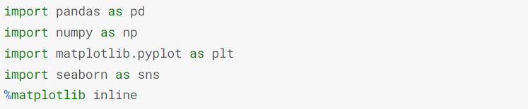
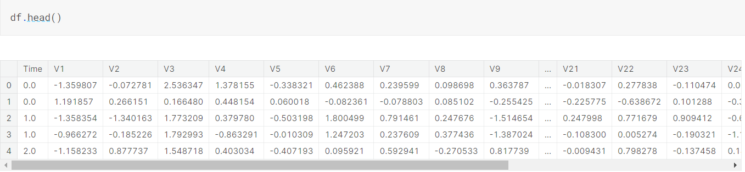
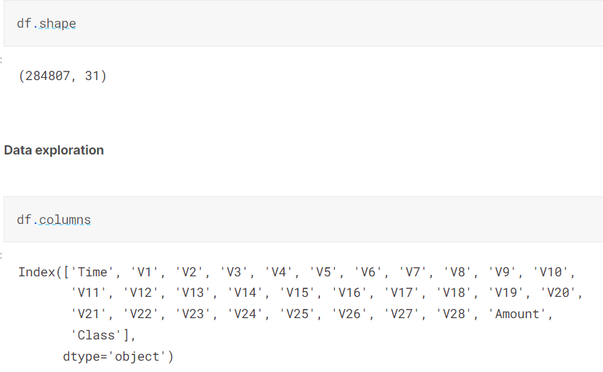
df = pd.read_csv(r"D:\DS_PROJECTS\Support_Vector_Machine\creditcard.csv")

Slide 4
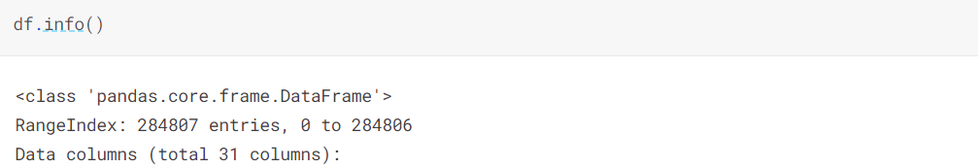
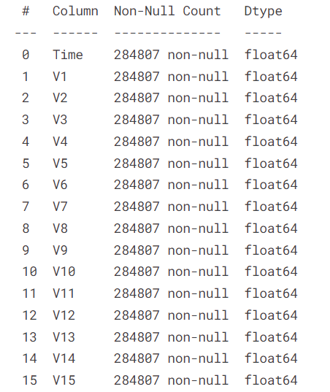
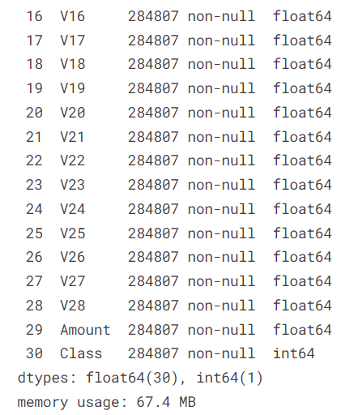

Slide 5
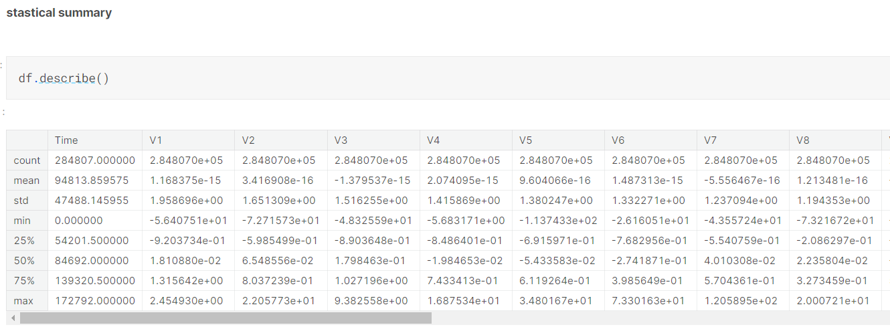
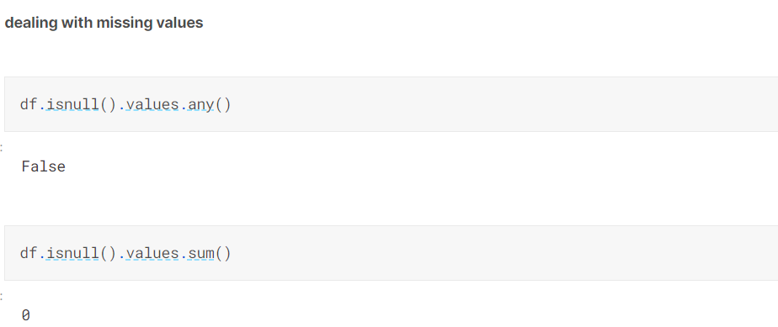

Slide 6
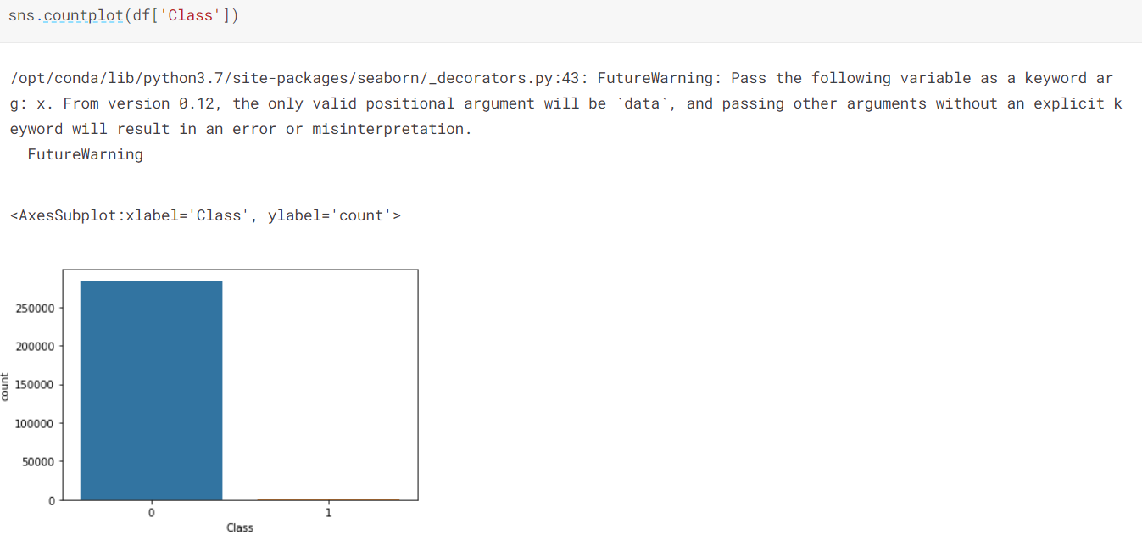
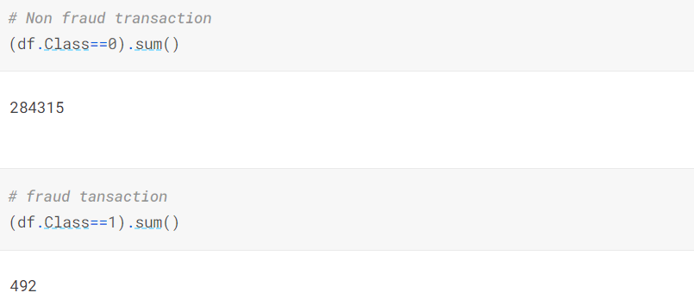
Countplot :

Slide 7
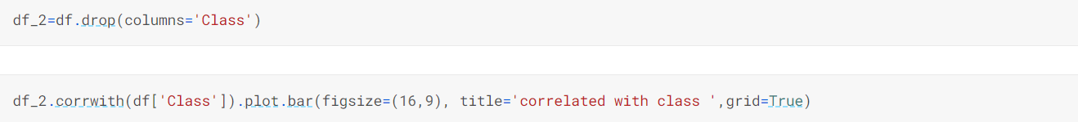
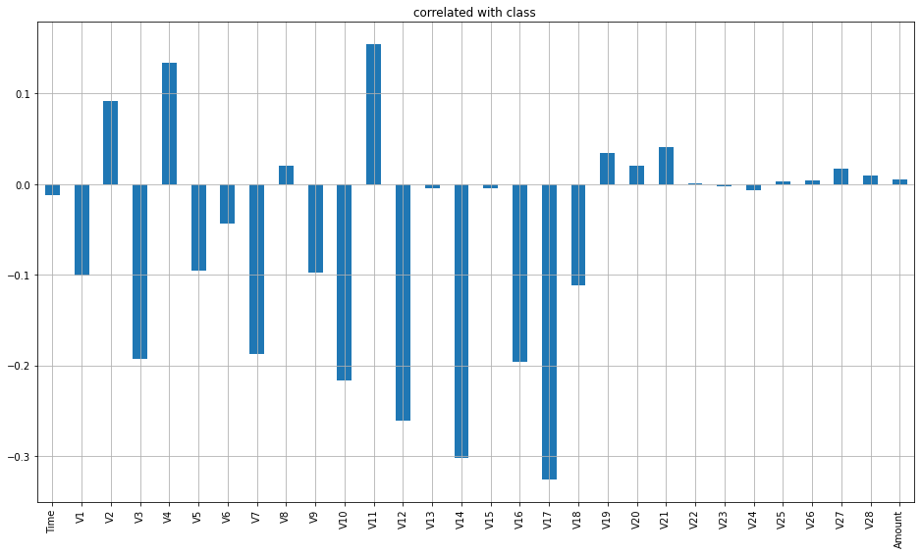
Correlation matrix and heat map :
<AxesSubplot:title={'center':'correlated with class '}>

Slide 8
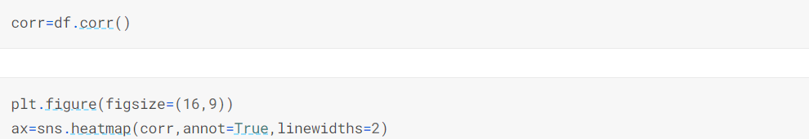
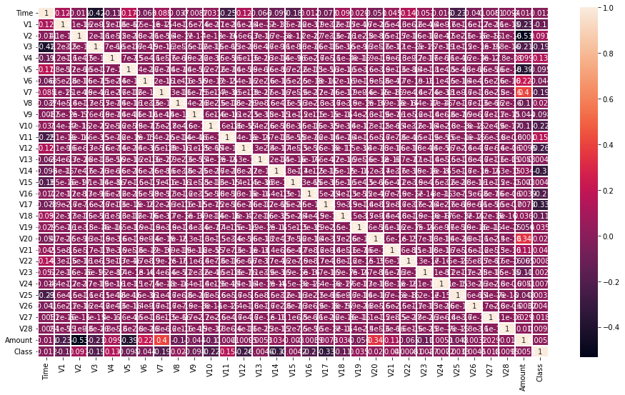

Slide 9
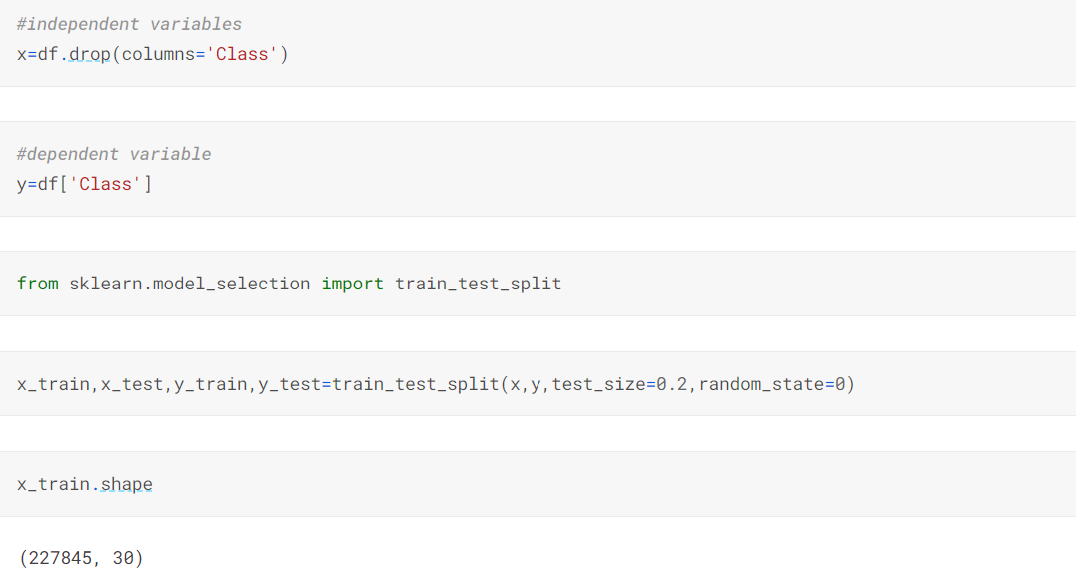
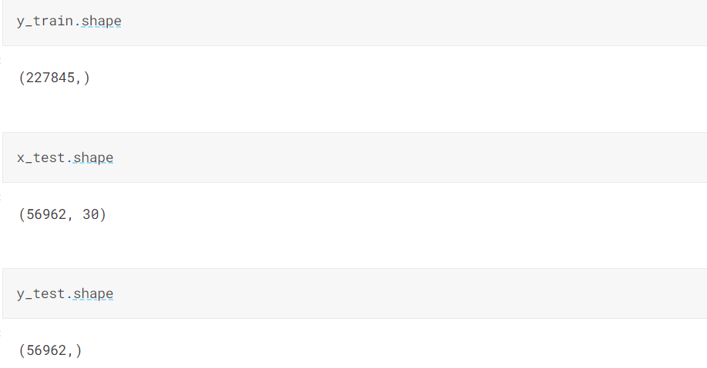

Slide 10
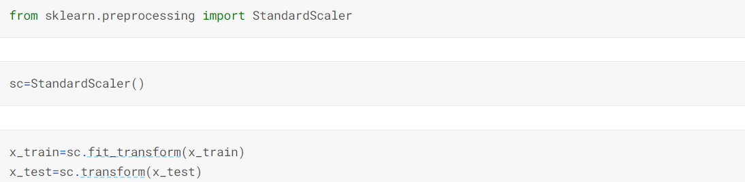
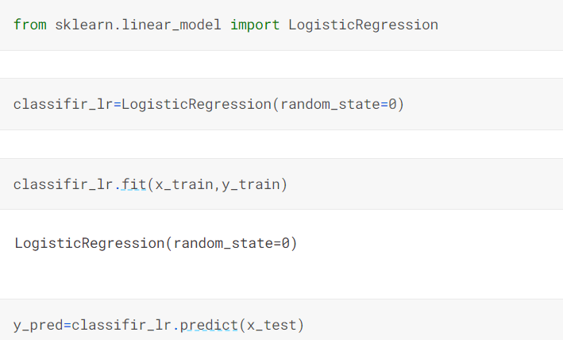
Feature scaling :
Building the model :
Logistic regression :

Slide 11
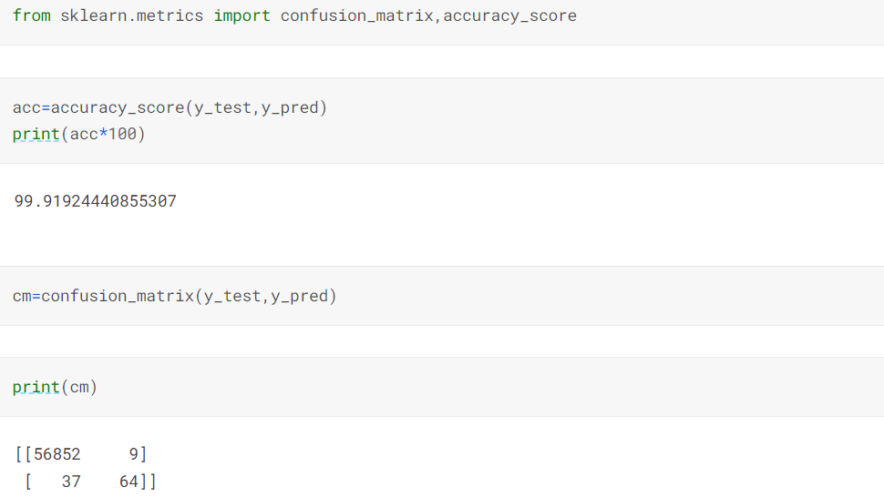
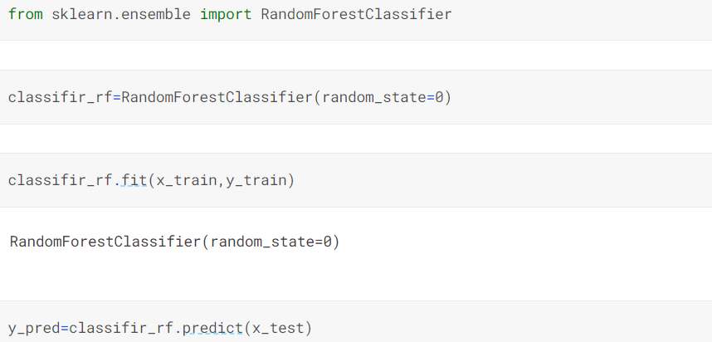
Accuracy and Confusion Matrix of Logistic Regression Model :
Random forest :

Slide 12
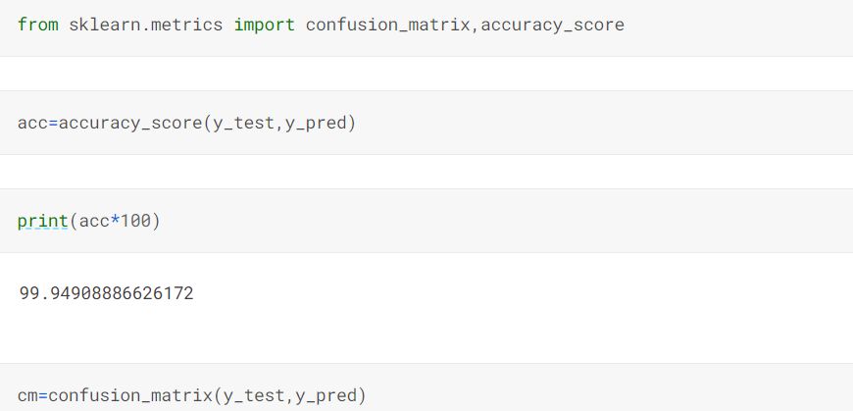
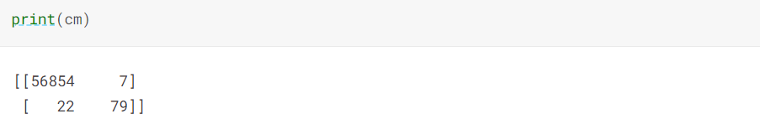
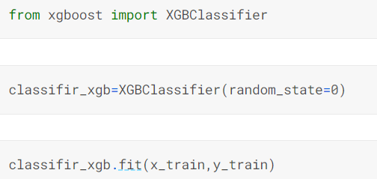
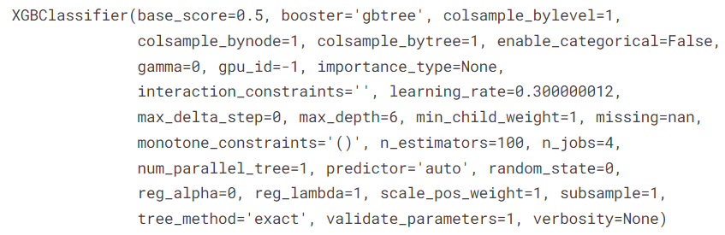
Accuracy and Confusion Matrix of Random Forest Classifier :
XGB Boost Classifier :
y_pred=classifir_xgb.predict(x_test)

Slide 13
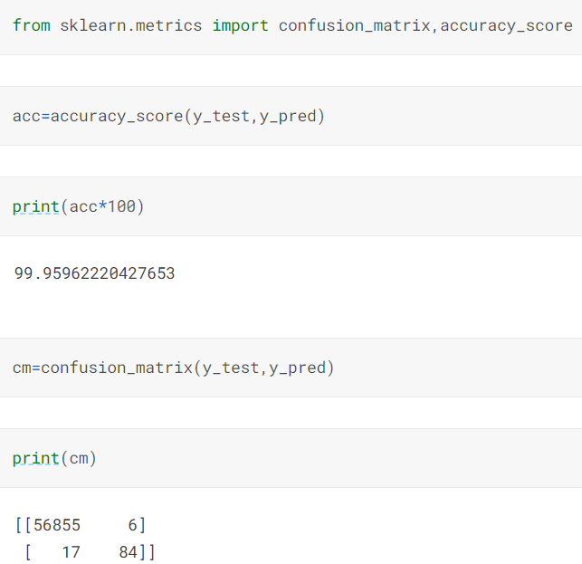
Accuracy and Confusion Matrix of XGB boost Classifier Model :

Slide 14
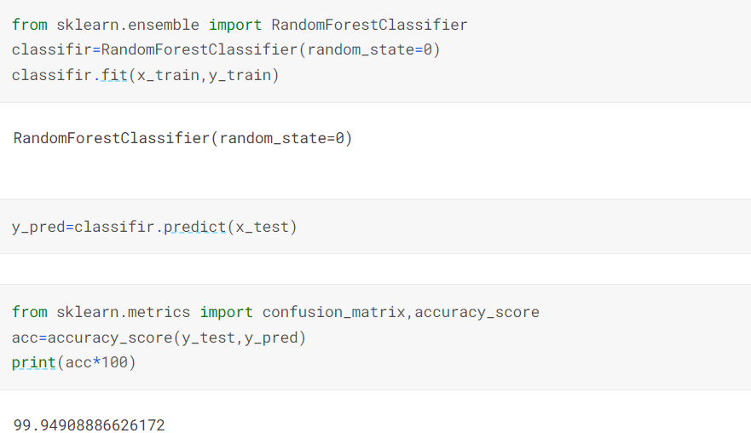
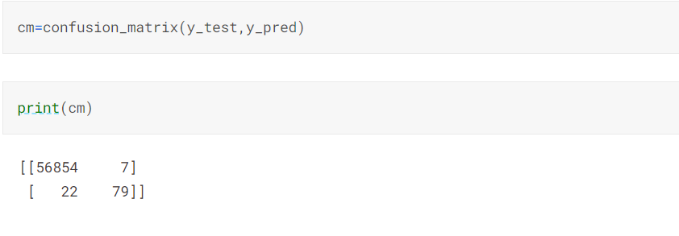
final model(random forest) :

Slide 15
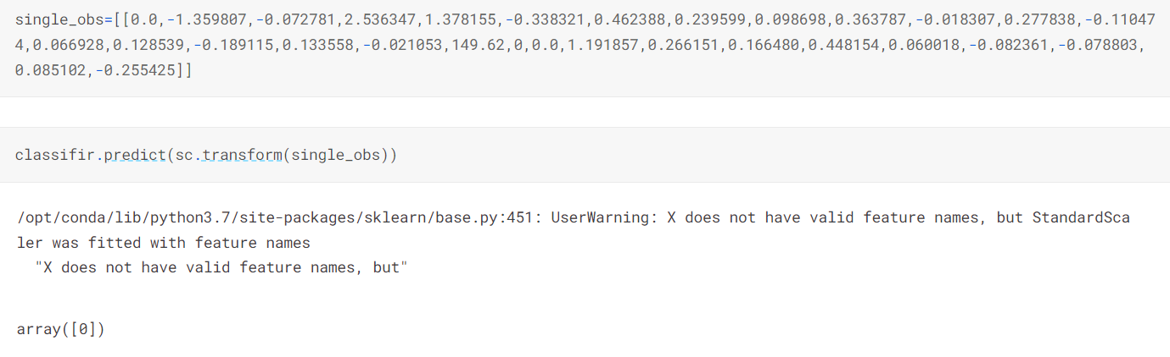

Slide 16
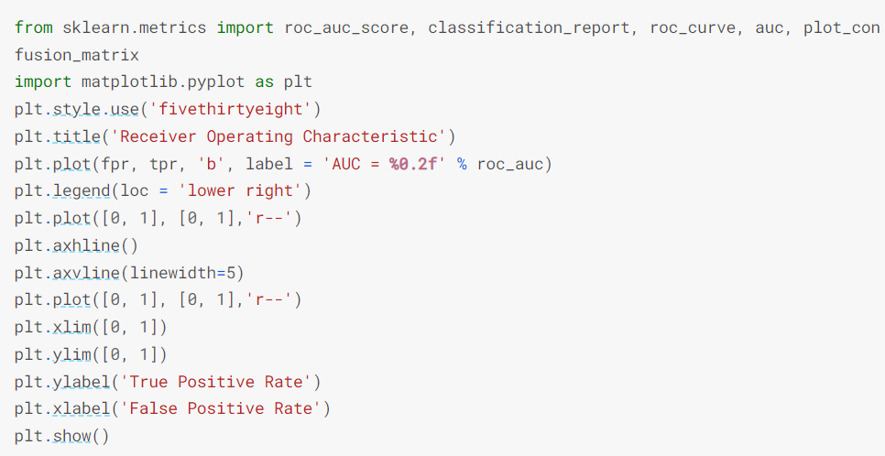
# calculate roc curve :
from sklearn.metrics import roc_auc_score, classification_report, roc_curve, auc, plot_confusion_matrix
fpr,tpr,thresholds = roc_curve(y_test,y_pred)
roc_auc = auc(fpr,tpr)
roc_auc
0.5624882776325506

Slide 17
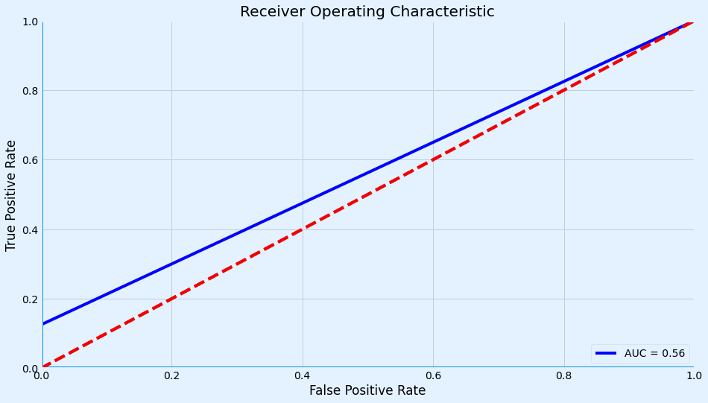

Slide 18


